Slide 1
Bitcoin Mining

Slide 2
PoW Recap
Mining entity 1
Joint mining
Mining entity 2
Extension of current head

Slide 3
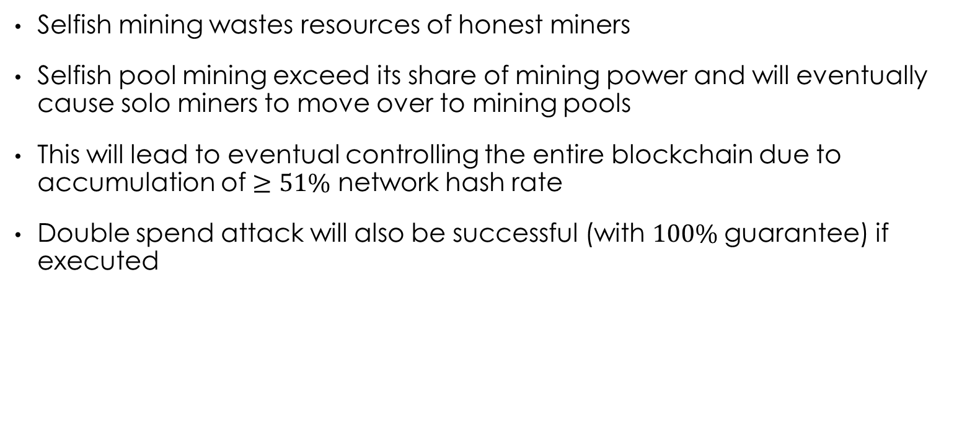
Problems of current PoW implementation
Selfish mining wastes resources of honest miners
Selfish pool mining exceed its share of mining power and will eventually cause solo miners to move over to mining pools
This will lead to eventual controlling the entire blockchain due to accumulation of $≥51\%$ network hash rate
Double spend attack will also be successful (with $100\%$guarantee) if executed

Slide 4
Selfish mining
Primary motivation is to force the honest miners into mining blocks on the chain that will become stale, thereby wasting computational resources
Selfish miners selectively reveal their blocks (completed but hidden and not propagated) to invalidate the honest miners’ work
While doing so, selfish miners will continue to mine on its own private chain
If selfish miners have less computational power than the honest miners, then the goal is to get the honest miners to abandon their shorter chain and mine on their private chain (which is longer), thereby invalidating all of the honest miners’ blocks.
This will allow the selfish miners’ to obtain the block rewards

Slide 5
Selfish mining
Honest miners (Solo/Pool)
When selfish miners find a block, they do not propagate to the network and continue mining
Either selfish miners continue to find a next block; or
Selfish miners (Pool)
Honest miners find a block and nullify the lead that selfish miners have, then the selfish miners will publish their block also. *Selfish miners will continue to mine on their own chain while honest miners can select which chain to continue from

Slide 6
Selfish mining
Honest miners (Solo/Pool)
If the selfish miners manage to find another block, it will immediately publish the block to obtain the block reward for both blocks
Selfish miners (Pool)

Slide 7
Selfish mining (Other cases)
Honest miners (Solo/Pool)
If the selfish miners private chain is longer than the public chain, the private chain can continue to hide its chain to maximise the amount of wasted resources from the honest miners
Selfish miners (Pool)

Slide 8
Selfish mining
Honest miners (Solo/Pool)
The private chain first finds the block, but hides until the public chain publishes the block.
The selfish miners quickly publish the block at the same time. The selfish miners continue to mine on their chain while the honest miners can select which chain to mine since both were publish at the same time.
Selfish miners (Pool)

Slide 9
Selfish mining (Other cases)
Honest miners (Solo/Pool)
If the private chain is extended, the block published lets the selfish miners obtain 1 block reward while the honest miners get 1 block reward (instead of 2)
Selfish miners (Pool)

Slide 10
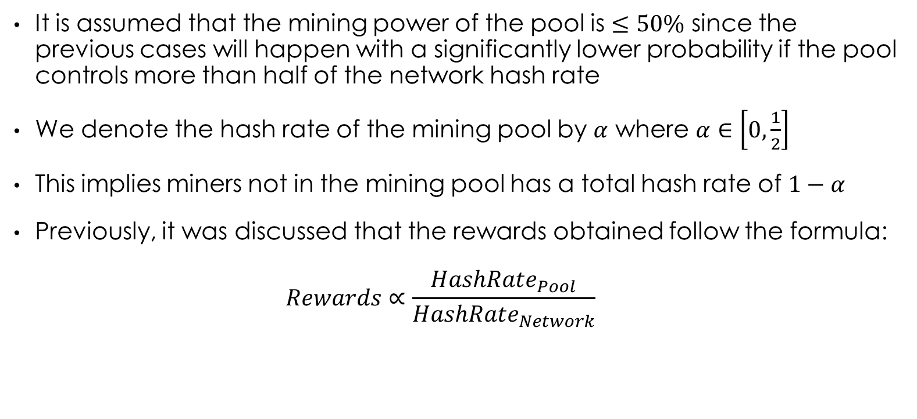
Mining power
It is assumed that the mining power of the pool is $≤50\%$ since the previous cases will happen with a significantly lower probability if the pool controls more than half of the network hash rate
We denote the hash rate of the mining pool by $α$ where $α∈\left[0,\frac{1}{2}\right]$
This implies miners not in the mining pool has a total hash rate of $1−α$
Previously, it was discussed that the rewards obtained follow the formula: $Rewards∝\frac{HashRate_{Pool}}{HashRate_{Network}}$

Slide 11
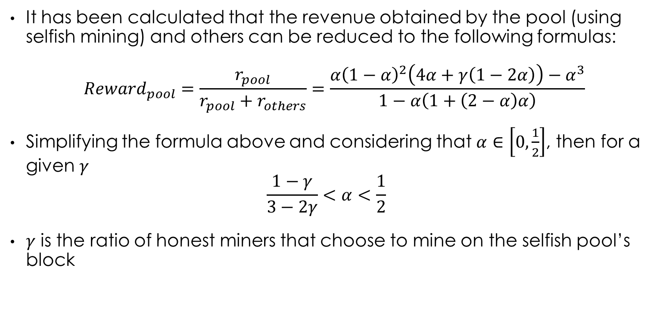
Mining power
It has been calculated that the revenue obtained by the pool (using selfish mining) and others can be reduced to the following formulas:
$$Reward_{pool}=\frac{r_{pool}}{r_{pool}+r_{others}}=\frac{α{\left(1−α\right)}^{2}\left(4α+γ\left(1−2α\right)\right)−α^{3}}{1−α\left(1+\left(2−α\right)α\right)}$$
Simplifying the formula above and considering that $α∈\left[0,\frac{1}{2}\right]$, then for a given $γ$ $\frac{1−γ}{3−2γ}<α<\frac{1}{2}$
$γ$ is the ratio of honest miners that choose to mine on the selfish pool’s block
[1]
Notes:
Skip the maths since proof in another paper
1st formula is a concatenation of 6 cases

Slide 12
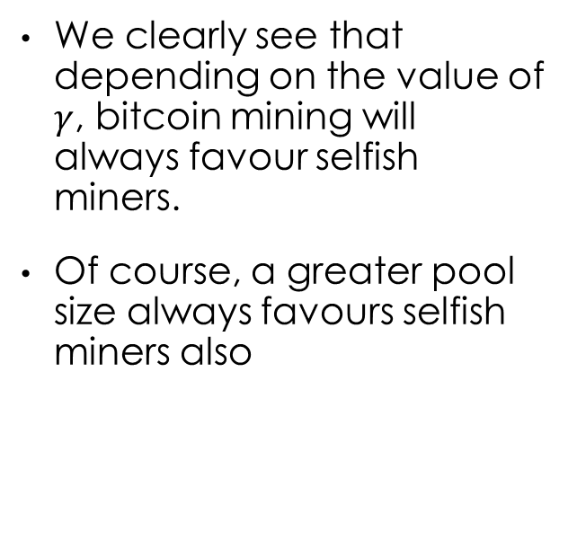
Selfish pool rewards
We clearly see that depending on the value of $γ$, bitcoin mining will always favour selfish miners.
Of course, a greater pool size always favours selfish miners also

Slide 13
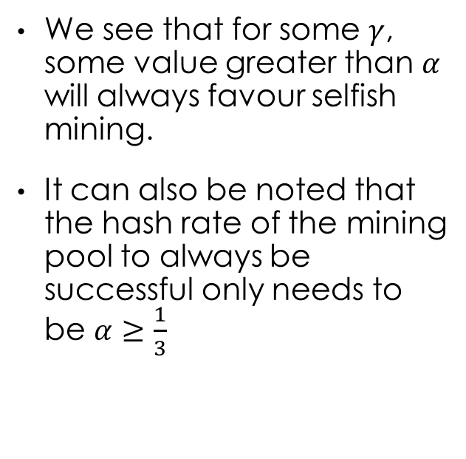
Minimum size of pool
We see that for some $γ$, some value greater than $α$ will always favour selfish mining.
It can also be noted that the hash rate of the mining pool to always be successful only needs to be $α≥\frac{1}{3}$

Slide 14
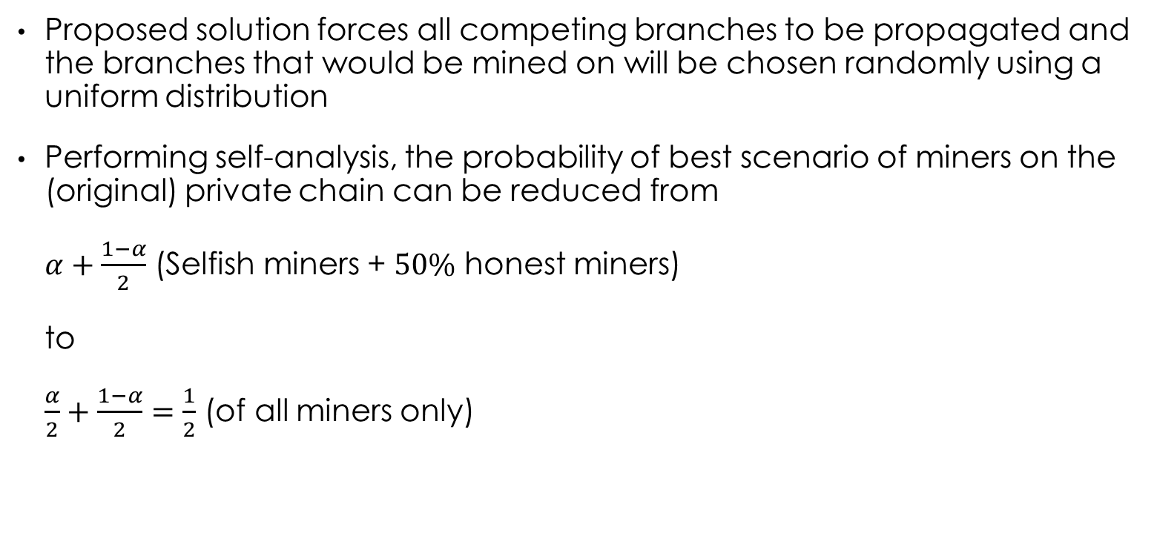
Protocol implementation
Proposed solution forces all competing branches to be propagated and the branches that would be mined on will be chosen randomly using a uniform distribution
Performing self-analysis, the probability of best scenario of miners on the (original) private chain can be reduced from $α+\frac{1−α}{2}$ (Selfish miners + $50\%$ honest miners) to $\frac{α}{2}+\frac{1−α}{2}=\frac{1}{2}$ (of all miners only)

Slide 15

Protocol implementation
By random assignment of miners to each branch, there is a decreased probability of favoring the private chains
Implementing this protocol does not require a hard fork, as honest miners will not be affected even if this improvement protocol is implemented (since $1−α≥50\%$)

Slide 16
References
Eyal, I., Sirer, E.G.: Majority is not enough: Bitcoin mining is vulnerable. arXiv preprint arXiv:1311.0243 (2013)

